Slide 1
Enhancing Sentiment Analysis of Romanized Code- Mixed Nepali Social Media Text Through Monolingual Transformation
Safal Sharma
Computer Engineering
Gandaki College of Engineering and Science
Pokhara, Nepal
be2022ce162@gces.edu.np
Apar Poudel
Computer Engineering
Gandaki College of Engineering and Science
Pokhara, Nepal
be2022ce161@gces.edu.np
Dr. Bidur Devkota
associate professor
Gandaki College of
Engineering and Science
Pokhara, Nepal
bidur@gces.edu.np

Slide 2
What is sentiment analysis?
Sentiment analysis is a process that uses natural language processing (NLP) and machine learning to identify and categorize the underlying emotional tone of a piece of text.
Practical Importance: Accurately evaluating sentiment in social media text provides crucial insights into public opinion and serves as a foundational step for broader NLP applications, such as the identification of online hate speech and the analysis of diverse regional dialects
Challenges Faced in Code-Mixed Languages
Lack of Standardized Orthography
Noise, Casual Slang, and Idioms
Inherent word-sense ambiguity
Noise, Casual Slang, and Idioms
The Rise of Romanized Script Usage and Its Impact on Transformer Models
While Romanized Nepali has become the dominant script for communication on social media platforms in Nepal, where popular transformer-based encoding models such as XLM-RoBERTa, mBERT, and MuRIL struggle with raw Romanized input and code-switching noise

Slide 3
How are social media texts?
vanja ta hero hudo raixa
yo kukur lai nxodnu dd
india ko rajkot bata herxu regular
news the very best

Slide 4
Objectives of the Study
Address the Script Gap Between Romanized Text and Formal Devanagari Models
Propose a Parallel Normalization Strategy for Better Sentiment Classification
Evaluate Performance Gains Using Monolingual Transformation

Slide 5
Related Works
Authors | Title
Pahari & Shimada (2023) | Language Preference for Expression of Sentiment for Nepali-English Bilingual Speakers on Social Media
Gupta, Joshi, & Bali (2020) | To Convert or Not to Convert: Back-Transliteration of Code-Mixed Text for Downstream NLP
Singh, Sen, & Kumar (2018) | A Twitter Sentiment Analysis Approach for Romanized Code-Mixed Hindi-English Text using Machine Translation
Joshi et al. (2016) | Towards Sub-word Level Language Identification for Intra-word Code-Switching in Hindi-English
Khanuja et al. (2021) | MuRIL: Multilingual Representations for Indian Languages
Conneau et al. (2020) | Unsupervised Cross-lingual Representation Learning at Scale (XLM-RoBERTa)
Winata et al. (2021) | Are Multilingual Models Effective in Code-Switching?
Adhikari et al. (2022) | COVID-19-Related Nepali Tweets Classification in a Low Resource Setting
Patwa et al. (2020) | SemEval-2020 Task 9: Overview of Sentiment Analysis of Code-Mixed Tweets
Gurung (2019) | Nepali-English Code-Switching in the Conversations of Nepalese People: A Sociolinguistic Study

Slide 6
Dataset Overview
The base corpus consists of 10,702 comments collected from YouTube (Pahari & Shimada).
Raw Text Format: The comments existed in raw Romanized script, containing non-standardized orthography, code-mixed Nepali-English phrases, and casual social media noise.
Each instance was annotated into one of three core sentiment categories: Positive, Neutral, or Negative
The base corpus is well-balanced across all three classes, preventing model bias toward any single sentiment category:
Positive: 3,460 comments (~32.3%)
Neutral: 3,648 comments (~34.1%)
Negative: 3,594 comments (~33.6%)
1079 committed were used for validation, and 1069 were used for the testing.

Slide 7
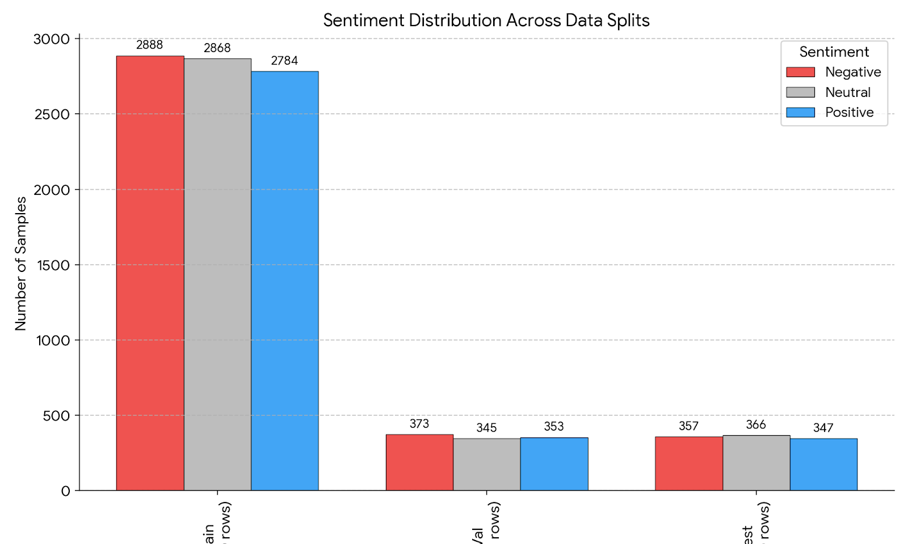
Distribution of details
Train: Negative (33.8%), Neutral (33.6%), Positive (32.6%)
Val: Negative (34.8%), Neutral (32.2%), Positive (33.0%)
Test: Negative (33.4%), Neutral (34.2%), Positive (32.4%)

Slide 8
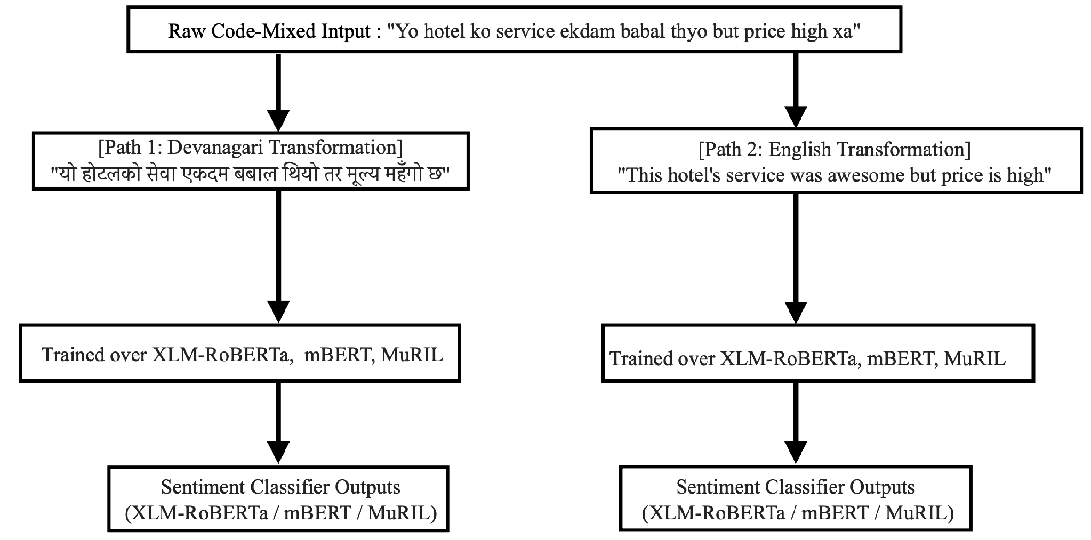
What we did ?

Slide 9
Transformer Model Architectures Overview
mBERT (Multilingual BERT): A multilingual transformer-based encoding model pre-trained on Wikipedia dumps across 104 languages using Masked Language Modeling (MLM).
Role in Experiment: Provides a baseline for multilingual representations, though performance on raw Romanized text is hindered by out-of-vocabulary tokens and informal code-switching noise
XLM-RoBERTa: A large-scale multilingual transformer model trained on over 2.5 TB of filtered Common Crawl data across 100 languages, utilizing an optimized RoBERTa pre-training approach.
Role in Experiment: Emerged as the top-performing model in the evaluation . Standardizing inputs to Devanagari allowed XLM-RoBERTa to overcome the "script gap," increasing its Macro F1 score from 0.67 on raw Romanized text to 0.7093 on normalized Devanagari

Slide 10
MuRIL:A pre-trained transformer model specifically engineered for Indic languages, trained on both monolingual and translated/transliterated parallel corpora from South Asian languages.
Role in Experiment: Specifically suited for Devanagari and regional linguistic patterns. Script normalization yielded similar performance gains for MuRIL by eliminating raw transliteration noise and aligning text with its Indic training representations

Slide 11
Experimental Setup
Transformer Architectures
Models:
mBERT: Wikipedia pre-trained
XLM-RoBERTa: CommonCrawl pre-trained
MuRIL: Indic-focused pre-trained
Training Hyperparameters & Evaluation Protocol
Training Configuration:
Optimizer: AdamW
Learning Rate: 1 * 10^-5
Epochs: 5 epochs

Slide 12
Evaluation Metrics:
Per-class F1 (Positive, Neutral, Negative), Macro F1, Weighted F1, and Accuracy

